Slide 1
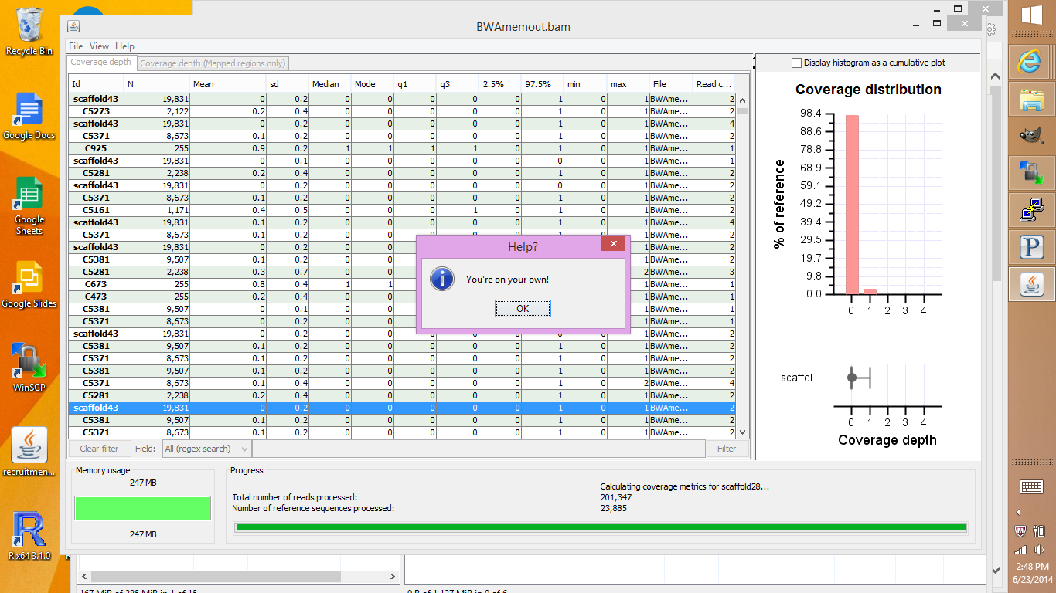

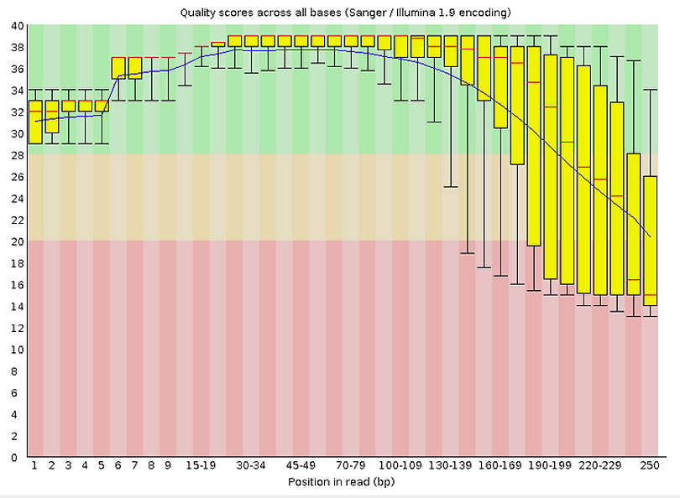

Slide 2
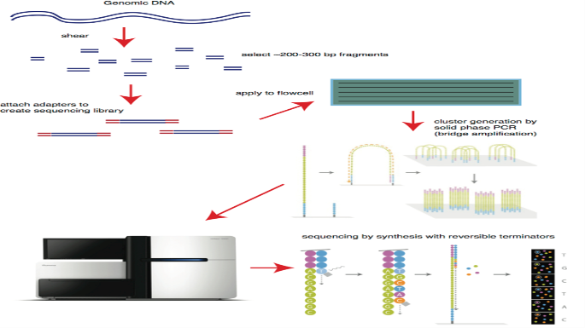
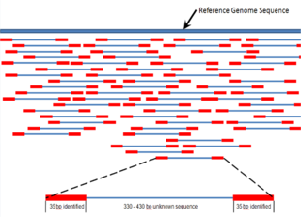
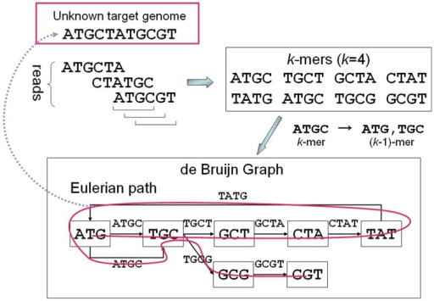
Assembly Basics
Illumina sequencing places a large amount of fragmented DNA into a ‘lane’ where it is amplified in place
Fastq sequence reads are generated from those clusters of DNA fragments.
Reads are broken into Kmers during the assembly.
Overlapping Kmers are formed into Contigs, which represent regions of Contiguous DNA.

Slide 3
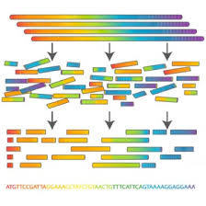
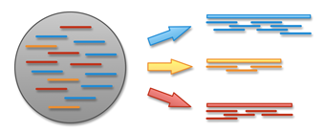
Metagenomic Assembly
All sequences are compared to each-other for metagenomic assembly.
Misassemblies and chimeras may result if hits are not aligned correctly.
A species will not be represented if the contigs are not made from a population.
Metagenomic Assembly
Genomic
Assembly
Notes:
3

Slide 4
Abundance from Assembly
There are two naive approaches to community abundance from sequencing:
counts of contigs matching a species
mapping reads back to a reference genome
Rank abundance curves are constructed from real examples of viromes
Using curves as a guide new communities are digitally simulated

Slide 5
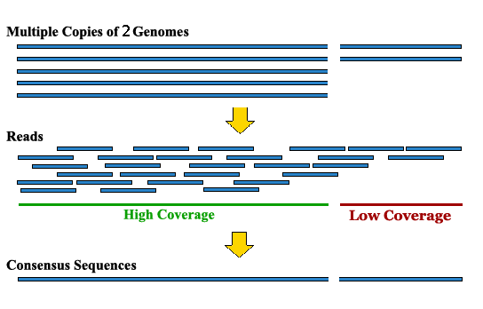
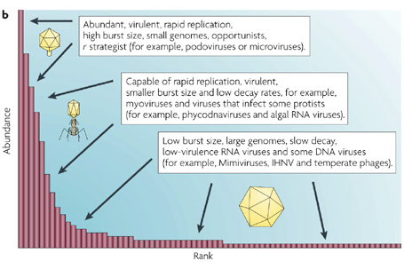
Different Strategy for Abundance
If coverage of a contig is how many DNA matches per unit length then, would how many of species in a population be predictable from the coverage of a contig.
?

Slide 6
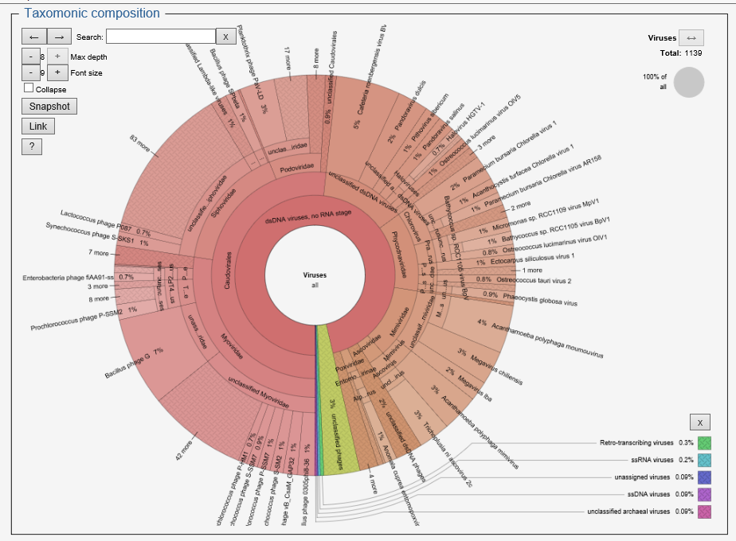
Ocean Viral Abundance Sample

Slide 7
Error modeling
The read simulators make an attempt to provide data as close to illumina’s output as possible
The error profile created from our SERC reads shows a curved error model.
SimSeq’s error model is generated from multiple datasets of paired end 250 data.
Grinder was given a uniform error model to alleviate problems from the assembly.

Slide 8
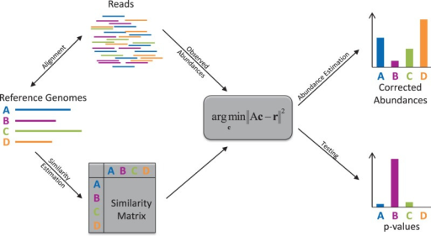
Read Based Reference Mapping
Reads from sequencing output are put into a read mapper to match against reference genomes
The matches are abundances of that reference within a population

Slide 9
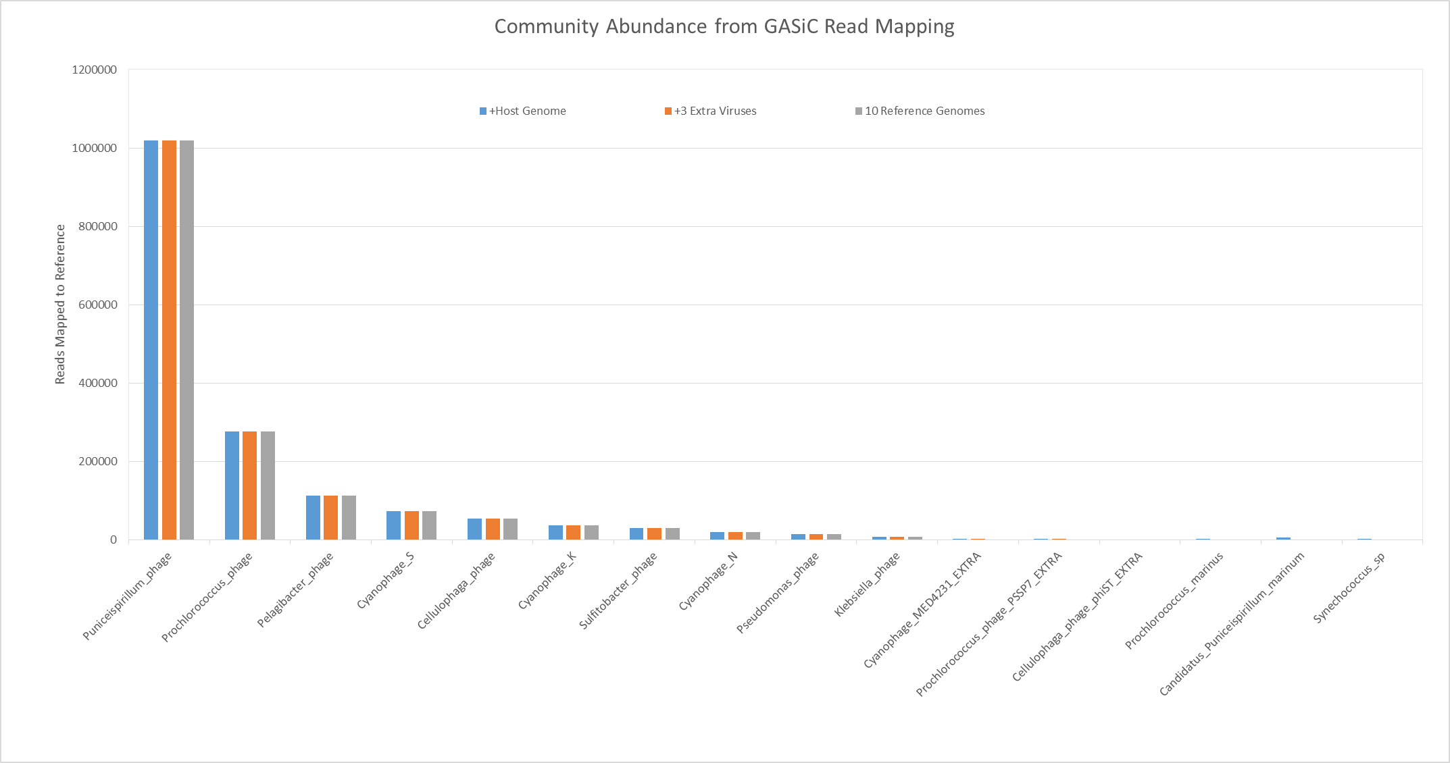
GASiC Results
GASiC | 10 Reference Viuses | 10 RefVir + 3 Close Relatives | 10 RefVir + 3 Relatives + 3 Host Bacterial Genomes
Total mapped reads | 1643253 | 1646927 | 1653313
Estimated reads | 1641520 | 1641520 | 1641520
Difference | 1733 | 5406 | 11793
Percent error | 0.1056% | 0.3294% | 0.7184%

Slide 10
Assembly Verification from Reads
Grinder read simulator outputs are compared with extra phages and bacterial reference genomes
Inputting extra information gives an estimation of how correctly the read mappers find their reference
Comparing two read simulators also provided an additional point of reference for future expectations. SimSeq was used as an comparator

Slide 11
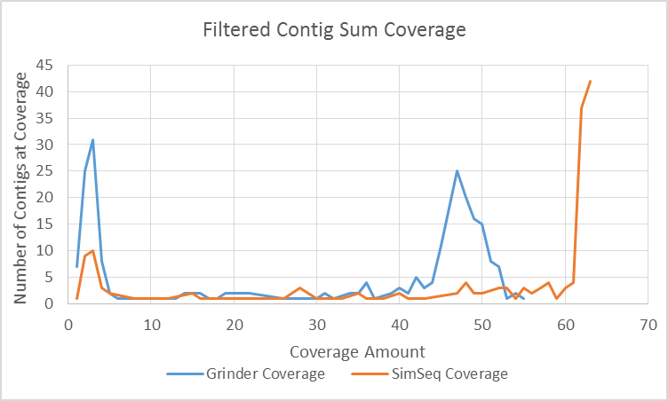
Community abundance from kmer coverage
Contigs with coverages are output from the SOAPdenovo assembler.
Coverages are compared within an assembly of the same in-silico reads.
A large number of Contigs with low and high coverage exist than with medium coverage.
Contigs with less than 600 bp in length have been filtered out to maintain high quality of data.

Slide 12
Another issue may be that the 2 read simulators created different length contigs from after the assembly.
This may mean that more of the genomes are spread over shorter contigs for the SimSeq read simulator.

Slide 13
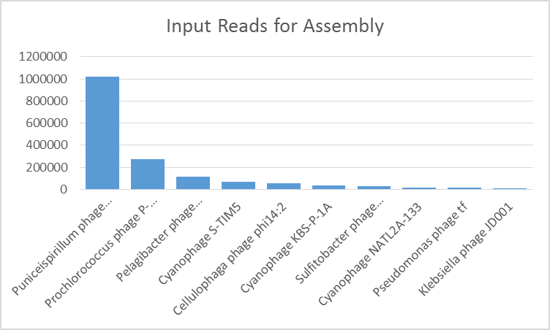
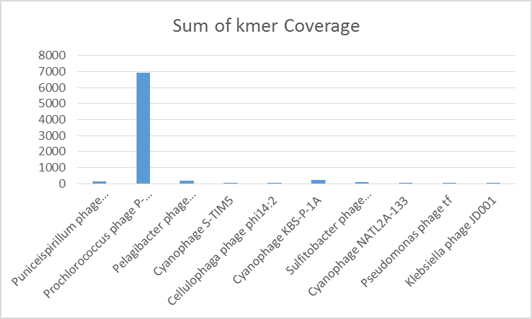
Results from Contig Coverage from Assembly
The output of the Grinder dataset has shown that contig coverage count does not correlate to the input of the dataset.
The SimSeq dataset has not been tested for correlation to the contig coverage yet.
Unfiltered reads have also not been tested to fit this curve.

